Slide 1


Unit - 6
Image Processing

Slide 2

Unit
Image Processing
6
Notes:
Dear Students, In today's session we are going to learn about Image processing

Slide 3


DISCLAIMER
The content is curated from online/offline resources and used for educational purpose only.

Slide 4

Learning Objectives
Understand the concept and basics of digital images, pixels, color models, and image types.
Define and interpret resolution, size, and aspect ratio in images.
Apply smoothing and sharpening to enhance image clarity.
Use thresholding methods to segment and interpret images.
Define image and explore OpenCV for basic image processing tasks.
Train and use image models with Google’s Teachable Machine.
Identify sustainable applications of image processing in green technology.
GOAL
Source :
www.freepik.com/

Slide 5
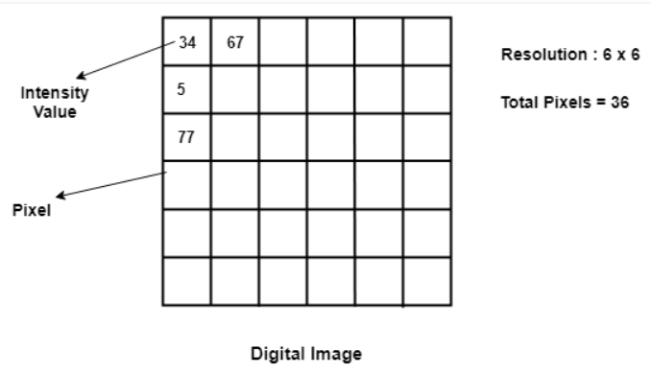
What is a Digital Image?
A digital image is like a picture made of tiny dots called pixels.
These pixels are arranged in rows and columns, similar to tiles on a floor.
Each pixel has a number that shows how bright or dark it is, helping to create the image we see.
Source :
https://theailearner.com/2018/10/06/what-is-a-digital-image/
Notes:
What is an Image?
An image is mathematically represented as a two-dimensional function f(x,y).
In digital images, each pixel is defined by its position within a 2D grid. The variables x and y represent these spatial coordinates or pixel locations, with x usually corresponding to the horizontal position and y to the vertical position. Every pixel’s position allows us to address or modify specific areas within the image.
Variables: x,y: Spatial coordinates (pixel locations).
f(x,y): Intensity or brightness at point (x,y).
f(x, y) represents the intensity (or brightness) value at the coordinate (x, y). In grayscale images, this is often a single value ranging from 0 (black) to 255 (white), where different values indicate varying levels of brightness. In color images, each pixel may have three intensity values (for red, green, and blue channels) instead of just one. Together, these intensity values help create the visible image by encoding light and color information for each pixel.
Image Representation
An image is composed of a grid of discrete values corresponding to x, y, and f(x, y), with each pixel representing the intensity at a specific coordinate. This digital representation enables computers to store, process, and analyze images as arrays of values, making it possible to manipulate individual pixels for a wide range of applications.
Image Processing
Image processing refers to a set of techniques applied to digital images to enhance, modify, or analyze them. The goal is often to make the image more useful or informative by adjusting its characteristics. For example, image enhancement techniques (like adjusting brightness or contrast) improve visual clarity, while image analysis methods (like edge detection) extract features for object recognition. Digital image processing is fundamental in fields like medical imaging, surveillance, and computer vision, where meaningful information must be gathered or highlighted.

Slide 6
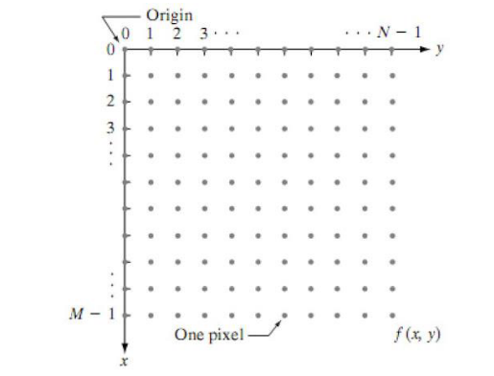
How are Images defined mathematically?
An image is mathematically represented as a two-dimensional function f(x,y).
Variables: x,y: Spatial coordinates (pixel locations).
f(x,y): Intensity or brightness at point (x,y).
An image of M * N dimension consists of discrete values for x,y and f(x,y), typically represented in pixels.
Source :
https://saineshnakra.medium.com/demystifying-cv-the-ultimate-guide-to-choosing-the-right-module-and-library-for-any-computer-86d35ac9fa8a
https://www.mrecacademics.com/DepartmentStudyMaterials/20201220-Digital%20Image%20Processing%20Notes.pdf
Notes:
What is an Image?
An image is mathematically represented as a two-dimensional function f(x,y).
In digital images, each pixel is defined by its position within a 2D grid. The variables x and y represent these spatial coordinates or pixel locations, with x usually corresponding to the horizontal position and y to the vertical position. Every pixel’s position allows us to address or modify specific areas within the image.
Variables: x,y: Spatial coordinates (pixel locations).
f(x,y): Intensity or brightness at point (x,y).
f(x, y) represents the intensity (or brightness) value at the coordinate (x, y). In grayscale images, this is often a single value ranging from 0 (black) to 255 (white), where different values indicate varying levels of brightness. In color images, each pixel may have three intensity values (for red, green, and blue channels) instead of just one. Together, these intensity values help create the visible image by encoding light and color information for each pixel.
Image Representation
An image is composed of a grid of discrete values corresponding to x, y, and f(x, y), with each pixel representing the intensity at a specific coordinate. This digital representation enables computers to store, process, and analyze images as arrays of values, making it possible to manipulate individual pixels for a wide range of applications.
Image Processing
Image processing refers to a set of techniques applied to digital images to enhance, modify, or analyze them. The goal is often to make the image more useful or informative by adjusting its characteristics. For example, image enhancement techniques (like adjusting brightness or contrast) improve visual clarity, while image analysis methods (like edge detection) extract features for object recognition. Digital image processing is fundamental in fields like medical imaging, surveillance, and computer vision, where meaningful information must be gathered or highlighted.

Slide 7

What is an Image Processing?
In digital techniques, the manipulation and analysis of images to enhance or gather meaningful information regarding them are usually referred to as image processing.
This is mainly used to enhance, modify, or analyze visual information.
Source :
www.flaticon.com
Notes:
What is an Image?
An image is mathematically represented as a two-dimensional function f(x,y).
In digital images, each pixel is defined by its position within a 2D grid. The variables x and y represent these spatial coordinates or pixel locations, with x usually corresponding to the horizontal position and y to the vertical position. Every pixel’s position allows us to address or modify specific areas within the image.
Variables: x,y: Spatial coordinates (pixel locations).
f(x,y): Intensity or brightness at point (x,y).
f(x, y) represents the intensity (or brightness) value at the coordinate (x, y). In grayscale images, this is often a single value ranging from 0 (black) to 255 (white), where different values indicate varying levels of brightness. In color images, each pixel may have three intensity values (for red, green, and blue channels) instead of just one. Together, these intensity values help create the visible image by encoding light and color information for each pixel.
Image Representation
An image is composed of a grid of discrete values corresponding to x, y, and f(x, y), with each pixel representing the intensity at a specific coordinate. This digital representation enables computers to store, process, and analyze images as arrays of values, making it possible to manipulate individual pixels for a wide range of applications.
Image Processing
Image processing refers to a set of techniques applied to digital images to enhance, modify, or analyze them. The goal is often to make the image more useful or informative by adjusting its characteristics. For example, image enhancement techniques (like adjusting brightness or contrast) improve visual clarity, while image analysis methods (like edge detection) extract features for object recognition. Digital image processing is fundamental in fields like medical imaging, surveillance, and computer vision, where meaningful information must be gathered or highlighted.

Slide 8
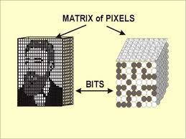
Key Concept of Image Processing
Pixel
A pixel is the smallest unit of a digital image or display.
Each pixel corresponds to a point in the image with a defined intensity and color value.
Pixel Grid Structure:
Pixels arranged in a matrix/grid format.
Pixel positions are based on row and column locations in the grid.
Each pixel's value reflects its intensity in grayscale or color.
Source :
http://www.sprawls.org/resources/DICHAR/module.htm
Notes:
Key Concept of Image Processing
Pixel
A pixel is a basic unit of digital image or screen-in other words, the "building block" of an image. Each pixel defines a single point in space that possesses values of intensity and color. Therefore, every pixel contributes to the appearance of the image itself. If you look at an image on a screen, you are literally seeing a grid of tiny points called pixels. Pixels form in a matrix and describe the position of each pixel by row and column in the matrix. This makes it possible to control, with exact accuracy, the layout and quality of the image. The value of pixels can indicate some form of intensity of the grayscale or, in the case of color images, the particular value of color that sums up to the detailed visuals we see on the screen.

Slide 9
Key Concept of Image Processing
Color Models
Frameworks for representing colors in images
Types
RGB (Red-Green-Blue)
CMY(K) (Cyan-Magenta-Yellow-Key/Black)
LAB Lightness-A-B
HSV (Hue-Saturation-Value)
Source :
https://www.vistaprint.com/hub/correct-file-formats-rgb-and-cmyk https://www.luxury-minds.com/what-is-lab-color-space-and-what-should-you-know-about-it-print-peppermint https://www.researchgate.net/figure/Conceptual-depiction-of-the-Hue-Saturation-Value-HSV-space-at-the-heart-of-our-first_fig2_340001129
Notes:
Key Concept of Image Processing
Color Models
Color models describe how colors are used in digital images. Different color channels or components, each model uses to make a spectrum of colors and can be selected according to the application for which the image is intended:
RGB (Red-Green-Blue):
RGB uses three primary color channels: Red, Green, and Blue.
Colors are formed by adding different intensities of these three colors. For example, pure Red is RGB = (255, 0, 0), Green RGB = (0, 255, 0) and Blue RGB = (0, 0, 255). The reason why RGB has gained popularity is that the way it represents colors in simple terms; it's extensively used in digital display, computer graphics, and image editing.
CMY(K) (Cyan-Magenta-Yellow-Key/Black):
Uses Cyan, Magenta, Yellow three colors for printing. With Black (K) adding depth. It's Subtractive mode of printing. It subtracts the light away - Cyan takes out red, Magenta removes green, and Yellow absorbs blue. Principally Color prints. For example, Cyan(100, 0, 0, 0), Magenta(0, 100, 0, 0), Yellow (0, 0, 100, 0), Black (0, 0, 0, 100).
LAB Lightness-A-B:
This LAB model comprises three channels- Lightness L, A and B are green to red, blue to yellow respectively. It is built to give how a human brain perceives the color difference, therefore perceptually uniform. It is mostly used when very good color differentiation is needed such as in color correction, and advanced image editing, etc.
HSV (Hue-Saturation-Value):
Hue (color type), Saturation (color intensity), and Value (brightness). Often visualized as a cone or cylinder where hue is the angle, saturation is the radius, and value is the height. Useful in color filtering, image segmentation, and human-centered design, as it aligns closely with human color perception. A red hue might be represented as (0°, 100%, 100%), where hue is in degrees.

Slide 10
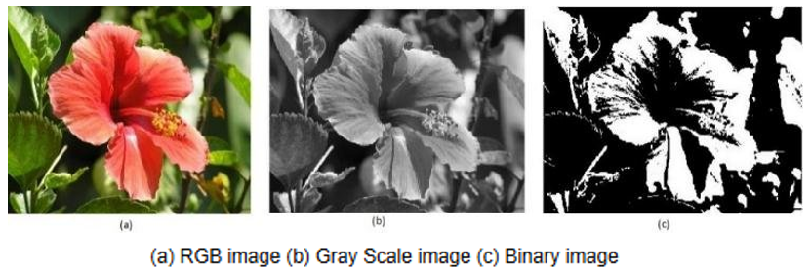
Key Concept of Image Processing
Image Types
Images are classified according to the number of values a pixel can take
Color Images
Grayscale Images
Binary Images
Source :
https://www.researchgate.net/figure/Figure2-a-RGB-image-b-Gray-Scale-image-c-Binary-image_fig2_344249310
Notes:
Key Concept of Image Processing
Image Types
Images are classified according to the number of values a pixel can take, and each type is used for a different purpose:
Binary Images:
Consist of only two colors, usually black and white. Helpful for simple graphics and document scanning where the presence or absence of an element is required, such as in text and line detection.
Grayscale Images:
Grayscale images contain different shades of gray. The intensity values vary from black that is 0 to white that is 255. It is widely used in various applications such as edge detection, texture analysis, and in medical imaging, where intensity changes are more pronounced than colors.
Color Images:
Composed of a multi-channel format, like RGB, to represent the wide range of colors. Most widespread in photography, video processing, and general digital media applications that require full-color representation.

Slide 11
Image Processing
Image processing is the use of algorithms and techniques to analyze, manipulate, and enhance digital images.
Image processing stages:
Image Acquisition
Capturing images using cameras or sensors.
Preprocessing
Preparing images by reducing noise, adjusting brightness
Segmentation
Dividing an image into meaningful regions
Classification and Analysis
Feature Extraction
Identifying specific features, like patterns or shapes
Using machine learning models to categorize or analyze features
Source :
Notes:
What is Image Processing?
Image processing is the use of algorithms and techniques to analyse, manipulate, and enhance digital images. It plays a significant role in various applications, including medical imaging, security, and manufacturing. When applied to sustainability, image processing can support environmental monitoring, optimize natural resource management, and promote more sustainable practices across industries.
Image Processing Stages
1. Image Acquisition
The first step in the image processing workflow, where images are captured using cameras or sensors.
This stage involves obtaining the raw image data that will undergo further processing. The quality of the acquisition (e.g., resolution, sensor type) directly impacts the success of the subsequent stages.
2. Preprocessing
Preprocessing prepares the image by enhancing its quality and reducing unwanted elements. This step often involves noise reduction, adjusting brightness, or contrast enhancement to make the image clearer.
Common methods include Gaussian blur (for noise reduction) and histogram equalization (for brightness/contrast adjustment).
3. Segmentation
This step divides the image into meaningful regions based on certain criteria. It could be separating different objects, areas of interest, or classes within an image.
In agriculture, segmentation could differentiate between various plant types in a field, or in city planning, it could separate different areas of a city (residential, commercial, etc.).
4. Feature Extraction
After segmentation, this stage involves identifying specific features in the image, such as patterns, textures, or shapes that are relevant for further analysis.
Detecting the edges of objects in a landscape, identifying facial features in a photograph, or recognizing anomalies in satellite imagery.
5. Classification and Analysis
In this final stage, machine learning models are applied to analyze the features extracted from the image and classify them into predefined categories or groups.
Using machine learning algorithms to categorize images for specific applications like medical imaging (identifying diseases) or satellite imagery (classifying land types).

Slide 12

OpenCV - Real-Time Computer Vision
Created by Intel in 1999, now maintained by the OpenCV Foundation
Primarily developed for real-time computer vision and image processing
Applications: Facial recognition, object detection, motion tracking, augmented reality, and mobile robotics
Key Features of OpenCV:
Extensive Algorithm Library
Multi-Language Support
Cross-Platform Compatibility
Optimized for Real-Time Processing
Source :
https://en.wikipedia.org/wiki/
Notes:
OpenCV - Real-Time Computer Vision Library
OpenCV is widely used as open-source software library concerned with the field of computer vision as well as advanced machine learning applications. Originally developed in 1999 by Intel, OpenCV was later handed over to the global developers who maintain it. Through its continuous version, OpenCV is extensively applied in research, academia, and industries. It is a powerful infrastructure for real-time image and video processing, which is very important for a range of different applications in the areas of robotics, surveillance, augmented reality, and autonomous vehicles.
Key Features of OpenCV
1. Extensive Algorithm Library
OpenCV has an enormous repository of over 2,500 optimized algorithms ranging from classical to state-of-the-art techniques. These allow developers to implement such features as face detection, object recognition, motion tracking, among many others, thereby allowing incredibly fast prototyping and deployment of highly complex computer vision applications.
2. Multi-Language Support
To support developers with a wide range of programming environments, OpenCV supports interfaces in C++, Python, Java, and MATLAB. It is also compatible with prominent machine learning libraries, particularly TensorFlow and PyTorch, used in the Python workflow.
3. Cross-Platform Compatibility
OpenCV is designed in such a way that it is cross-platform and has compatibility with all platforms and operating systems like Windows, Linux, macOS, Android, and iOS. Therefore, applications developed with OpenCV can be easily deployed on any device from a desktop and mobile phone to an embedded system.
4. Optimized for Real-Time Processing
OpenCV is optimized particularly for real-time computer vision applications, which include autonomous vehicles and real-time surveillance. It uses advanced processor instructions such as MMX and SSE and can even utilize acceleration on graphics processing units by including CUDA and OpenCL for OpenCV. This enables it to absorb all the high throughput demanded by jobs of image and video processing with great efficiency so that high-performance requirements are achieved in the fast execution of real-time programs.

Slide 13
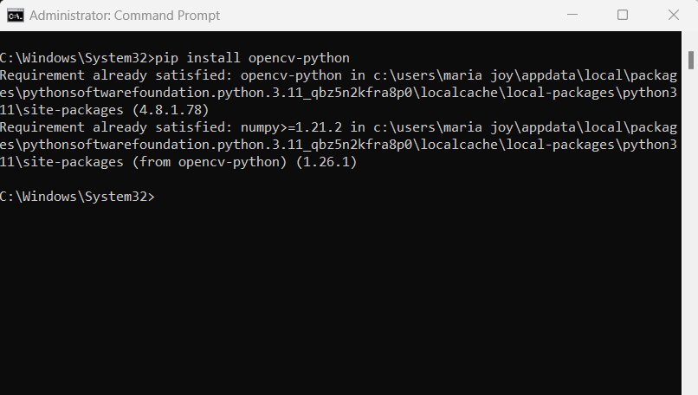
Installing OpenCV on Windows (Using pip)
The following are the steps to install OpenCV using pip
1. Check Python and pip:
python --version
pip --version
2. Open Command Prompt
3. Update pip
pip install --upgrade pip
4. Install OpenCV:
Basic installation: pip install opencv-python
With additional features: pip install opencv-contrib-python
5. Verify Installation:
import cv2
print(cv2.__version__)
Source :
Notes:
OpenCV - Real-Time Computer Vision Library
Here are the steps with explanations for installing OpenCV in Python:
Check Python and Pip:
To make sure Python and pip are installed, type the following commands in the command prompt or terminal:
python --version
pip --version
This will display the versions of Python and pip, confirming they’re installed and ready to use. If you don’t see a version number, you may need to install Python and pip first.
Open Command Prompt:
Open the command prompt (Windows) or terminal (macOS/Linux) to enter the commands for installing OpenCV and updating pip.
Update Pip:
Keeping pip updated ensures you can install the latest versions of packages. Update pip by entering:
pip install --upgrade pip
This command checks for the latest version of pip and upgrades it if necessary.
Install OpenCV:
There are two options for installing OpenCV, depending on the features you need:
Basic Installation (suitable for most uses):
pip install opencv-python
Installation with Extra Features (includes additional algorithms and features):
pip install opencv-contrib-python
If you’re planning to use special modules like cv2.aruco or cv2.xfeatures2d, use the second option.
Verify Installation:
Once installation is complete, you can verify that OpenCV is installed correctly by opening a Python interpreter and entering:
import cv2
print(cv2.__version__)
If OpenCV is installed successfully, this command will print the version of OpenCV. If there’s an error, you may need to troubleshoot the installation.

Slide 14
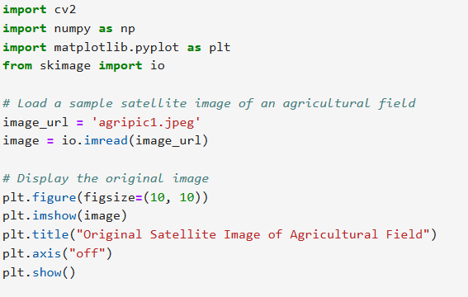
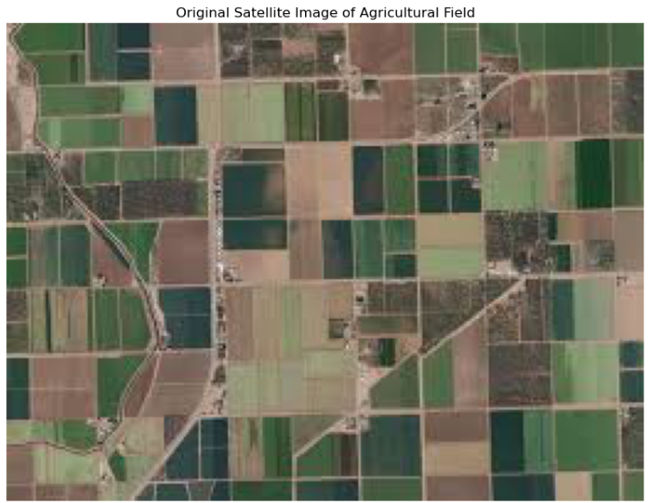
Example: With OpenCV
Using Python for Vegetation Health Detection
Source :
Notes:
This Python code loads and displays a satellite image of an agricultural field. First, it imports several libraries: cv2 for image processing, numpy for numerical operations, matplotlib.pyplot for plotting, and skimage.io for reading images. The image path is specified as agripic1.jpeg, and io.imread from skimage reads the image, storing it in the variable image.
To display the image, the code creates a figure with dimensions of 10x10 inches using plt.figure(figsize=(10, 10)). The plt.imshow function is used to show the image within this figure. A title, "Original Satellite Image of Agricultural Field," is added with plt.title, and plt.axis("off") hides the axes for a cleaner display. Finally, plt.show() renders the image in a pop-up or inline (if used in Jupyter Notebook) for viewing. This code is particularly useful for quick visualization and analysis of images in image processing tasks.

Slide 15
Image Processing using teachable machine
Teachable Machine uses a straightforward process where users can train a model on their own labeled image dataset.
Process involves the following steps:
Data Collection and Labelling
Upload images for each class the model should recognize
Assign categories to images to distinguish between them
Model Training
Uses deep learning algorithms to train
Involves multiple passes over the images to recognize patterns and features
Export and Deployment
Model can be exported as a TensorFlow or JavaScript model
Models can be integrated into web or mobile apps
Source :
Notes:
Image Processing using teachable machine
Teachable Machine uses a straightforward process where users can train a model on their own labelled image dataset. The process involves three primary steps:
Data Collection and Labelling: Users upload images for each class they want the model to recognize. For sustainability, these could be images of various recyclable materials (like plastics, glass, and metals), different plant species, or signs of pollution in natural landscapes. Each category is labelled accordingly, allowing the model to distinguish between them.
Model Training: Teachable Machine employs deep learning algorithms that train on the labelled images. Training involves multiple passes over the images to recognize patterns and features unique to each class. Teachable Machine makes this complex process easy to follow, with a training progress indicator and a test phase.
Export and Deployment: After training, the model can be exported as a TensorFlow or JavaScript model. This flexibility allows integration into web or mobile applications, making it highly versatile. Models can be run locally, which is important for privacy and low-energy deployment—key sustainability factors for reducing the carbon footprint associated with large-scale cloud processing.

Slide 16
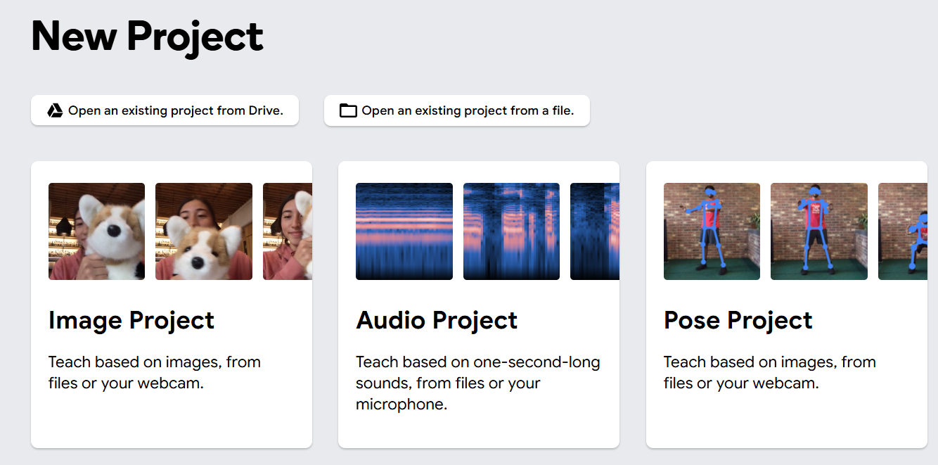
Example: Image Processing using teachable machine
Example : Create an image classification model for waste sorting
Step 1: Gather images for each waste category (Bottles, plastic bags, packaging materials)
Step 2: Training the Model with Teachable Machine
Open Teachable Machine:
Go to Teachable Machine.
(https://teachablemachine.withgoogle.com/)
Choose the Image Project option and then Standard Image Model.
Source :
Notes:
Integrate into an Application
Use your exported model in a simple web or mobile application. For example, a web app can use TensorFlow.js to classify images from a live camera feed, ideal for a recycling bin setup where users can check the category of waste in real-time.
Example,
Let's go through a practical example of using Teachable Machine to create an image classification model for waste sorting to help improve recycling efforts. The setup, training, and potential deployment of a model that can distinguish between types of waste, such as plastic, paper, glass, and organic materials.
Preparing the Dataset
Step 1: The first step is to gather images for each waste category. You’ll need a variety of images representing each type to account for differences in lighting, angles, and backgrounds. For example:
Plastic: Bottles, plastic bags, packaging materials
(https://www.kaggle.com/datasets/siddharthkumarsah/plastic-bottles-image-dataset)
For a simple project. You can capture these images yourself, or download sample images from free online sources.
Step 2: Training the Model with Teachable Machine
Open Teachable Machine:
Go to Teachable Machine.
(https://teachablemachine.withgoogle.com/)
Choose the Image Project option and then Standard Image Model.

Slide 17
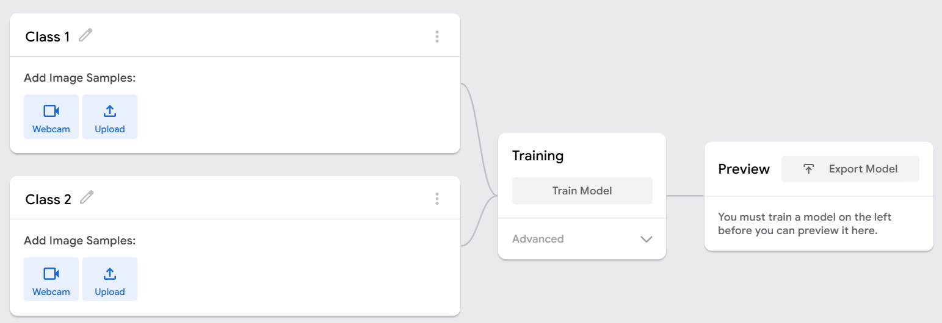
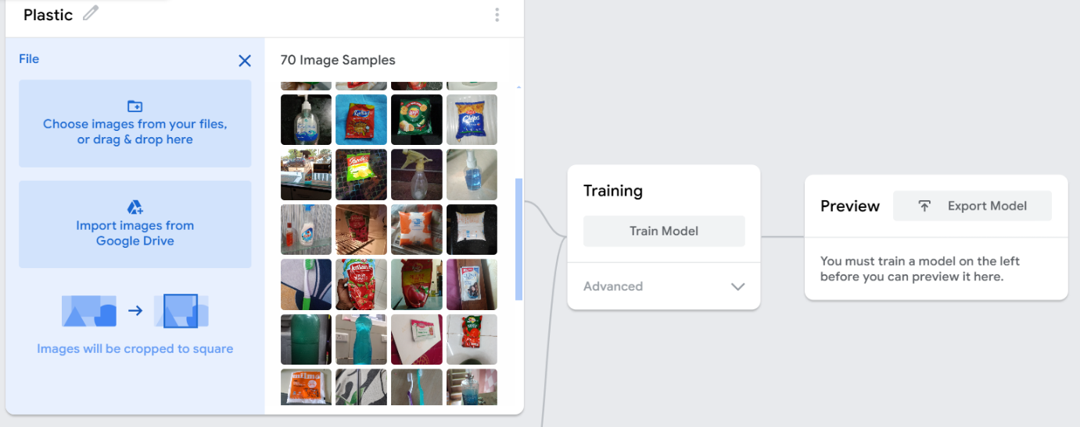
Example: Image Processing using teachable machine
Example : Create an image classification model for waste sorting
Step 3: Set Up Classes:
Rename the default class name to “Plastic.”
Click Add a Class for each waste type if required, and rename them as “Paper,” “Glass,” and “Organic Waste.”
Source :
Notes:
2.Set Up Classes:
Setting Up Classes for Waste Classification
Renaming Default Class:
When you first launch Teachable Machine, there is a default class labeled "Class 1.“ Rename this class to "Plastic" since this will be your first category for waste classification.
If necessary, you can add additional classes that will handle the rest of the types of waste.
To do this:
Click on "Add a Class."
Rename the new class to "Paper."
Proceed the same way to add classes for "Glass" and "Organic Waste" classes.
These are the categories of waste your model will learn to recognize.
Classes Description
Every class has a corresponding type of waste, and the identifiers used will train the machine to determine plastic, paper, glass, and organic wastes.
You will upload images for each class, wherein the model will learn to classify various types of wastes based on their provided features.

Slide 18
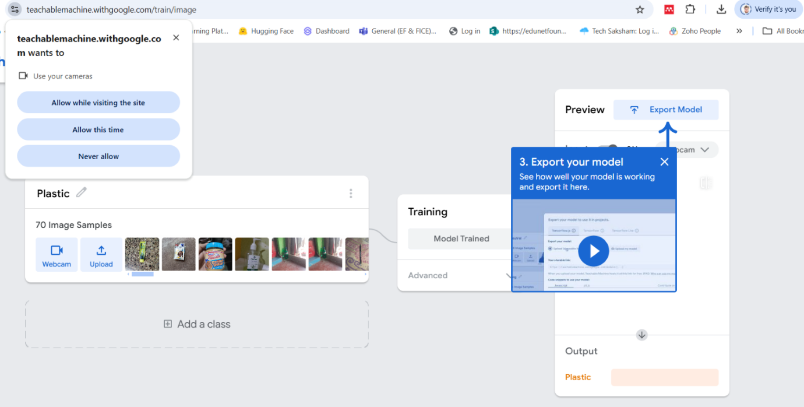
Example: Image Processing using teachable machine
Example : Create an image classification model for waste sorting
Step 4: Upload Images:
For each class, upload your prepared images.
Ensure that each waste type has enough examples for the model to learn distinct features.
Step 5:Train the Model:
After the images are uploaded and categorized, click on the Train Model button.
Source :
Notes:
Uploading Images and Training the Model
Step 4: Upload Images:
Upload Prepared Images
For each class (Plastic, Paper, Glass, Organic Waste), upload the prepared images that represent each waste type.
Ensure Sufficient Examples are provided. It's important to have enough images for each class to allow the model to learn distinct features of each waste type.
More data will lead to better model accuracy, so try to cover different scenarios for each waste type.
Step 5: Train the Model
Start Training
Once you’ve uploaded all your images and categorized them correctly, the next step is to train the model.
Simply click on the "Train Model" button to begin the process.
During training, Teachable Machine will use the images to learn the patterns and features associated with each waste type.
After training, the model will be ready to classify new images based on the features it has learned from your uploaded examples.

Slide 19
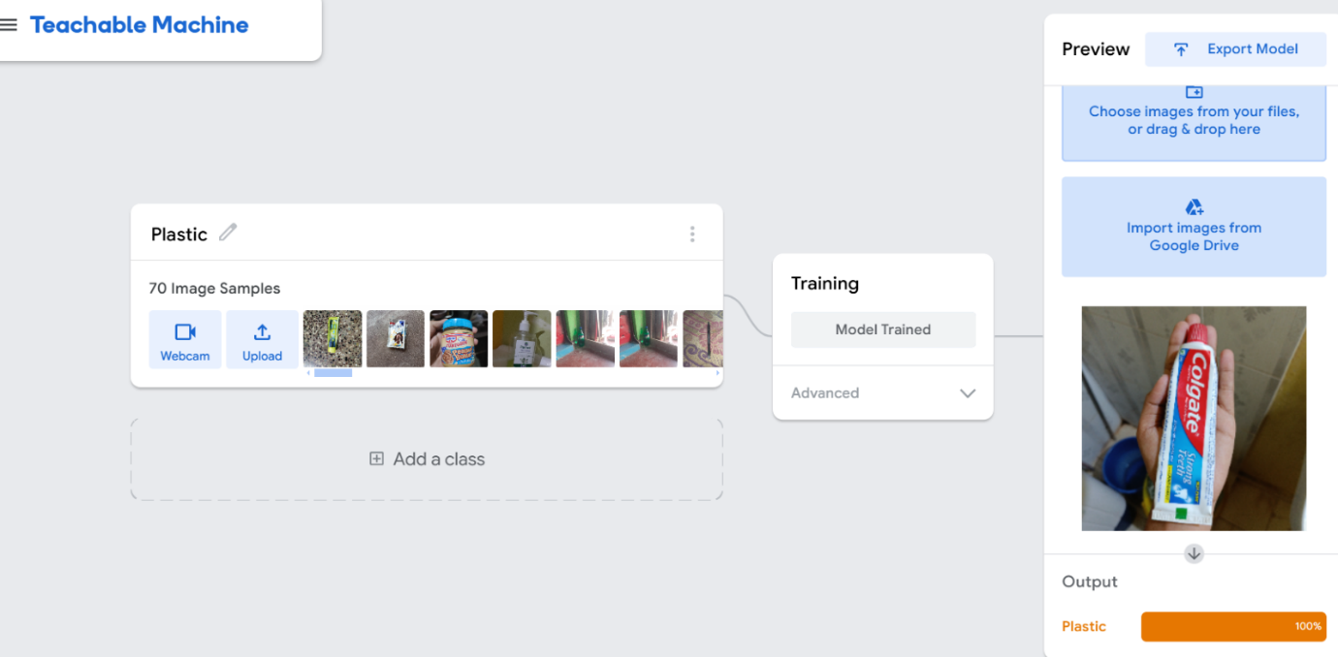
Example: Image Processing using teachable machine
Example : Create an image classification model for waste sorting
Step 6: Testing the Model:
Test the model by uploading or using the webcam to capture new images of each waste type.
The model will display predictions.
Source :
Notes:
2.Set Up Classes:
Setting Up Classes for Waste Classification
Renaming Default Class:
When you first launch Teachable Machine, there is a default class labeled "Class 1.“ Rename this class to "Plastic" since this will be your first category for waste classification.
If necessary, you can add additional classes that will handle the rest of the types of waste.
To do this:
Click on "Add a Class."
Rename the new class to "Paper."
Proceed the same way to add classes for "Glass" and "Organic Waste" classes.
These are the categories of waste your model will learn to recognize.
Classes Description
Every class has a corresponding type of waste, and the identifiers used will train the machine to determine plastic, paper, glass, and organic wastes.
You will upload images for each class, wherein the model will learn to classify various types of wastes based on their provided features.

Slide 20
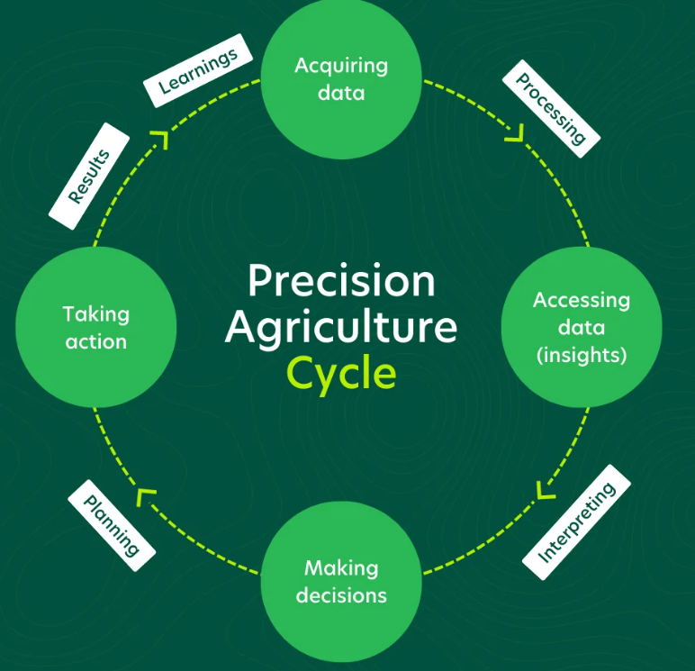
Applications of Image Processing with Green Technology and Sustainability
1. Precision Agriculture: Enhancing Farming with Image Processing
Crop Monitoring:
Monitors crop health and detects diseases early using satellite or drone images.
Water and Fertilizer Management:
Optimizes water and nutrient distribution based on soil and crop conditions.
Yield Prediction:
Analyzes past and current crop images to forecast yields more accurately.
Source :
https://www.farm21.com/understanding-precision-farming-metrics-and-how-you-can-benefit-from-them/
Notes:
Precision Agriculture
Crop Monitoring: Image processing helps monitor crop health and detect diseases early through satellite or drone images. Techniques like the Normalized Difference Vegetation Index (NDVI) allow farmers to assess plant health by analysing chlorophyll content and stress levels.
Water and Fertilizer Management: Image processing enables efficient water and nutrient distribution based on soil and crop conditions, minimizing excess use and promoting sustainable resource management.
Yield Prediction: By analysing past and present crop images, farmers can predict yields more accurately. This helps in planning and prevents overuse of fertilizers and pesticides, which reduces environmental impact.

Slide 21
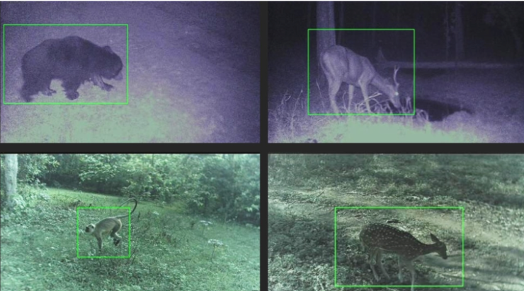
Applications of Image Processing with Green Technology and Sustainability
2. Forest and Wildlife Conservation
Deforestation Monitoring:
Track deforestation and changes in forest cover over time.
Identify illegal logging and allows timely interventions.
Wildlife Tracking
Drones and camera traps provide insights into species distributions, population dynamics, and behaviors.
Forest Health Assessment:
Detects diseases or stress (e.g., droughts, pests) affecting forests.
Enables early intervention and promotes sustainable forest management.
Source :
https://www.natural-solutions.world/blog/wildlife-conservation-artificial-intelligence-for-camera-trapping-1
Notes:
Forest and Wildlife Conservation
Deforestation Monitoring: Satellite and aerial images processed with machine learning can track deforestation and changes in forest cover over time. This real-time monitoring helps conservationists identify illegal logging activities and take timely actions.
Wildlife Tracking: Wildlife populations can be monitored through drones or camera traps, providing insights into species distributions, population dynamics, and behaviour. This data is crucial for protecting endangered species and preserving biodiversity.
Forest Health Assessment: Image processing can detect forest diseases or stress conditions due to droughts or pests, enabling preventive measures and more sustainable forest management.

Slide 22
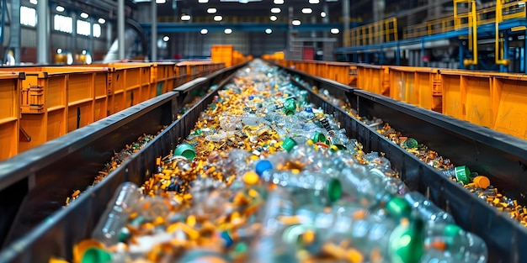
Applications of Image Processing with Green Technology and Sustainability
3. Waste Management and Recycling
Waste Sorting:
Advanced image recognition systems classify waste materials (like plastics, metals, and glass).
Landfill Monitoring:
Drones capture images of landfills to monitor waste accumulation.
E-Waste Management:
Image processing helps separate electronic waste components for recycling by identifying recyclable parts.
Source :
https://www.freepik.com/premium-ai-image/recycling-line-waste-sorting-plant-concept-waste-sorting-plant-recycling-process-sorting-line-environmental-impact-waste-management_252583248.htm
Notes:
Waste Management and Recycling
Waste Sorting: Advanced image recognition systems classify waste materials (like plastics, metals, and glass) on recycling conveyor belts, reducing contamination and improving recycling efficiency.
Landfill Monitoring: Drones capture images of landfills to monitor waste accumulation, methane emissions, and leachate management. This enables better control of pollutants and reduces the environmental impact of waste disposal.
E-Waste Management: Image processing helps separate electronic waste components for recycling by identifying recyclable parts. Efficient e-waste management reduces hazardous waste and supports sustainable material recovery.

Slide 23
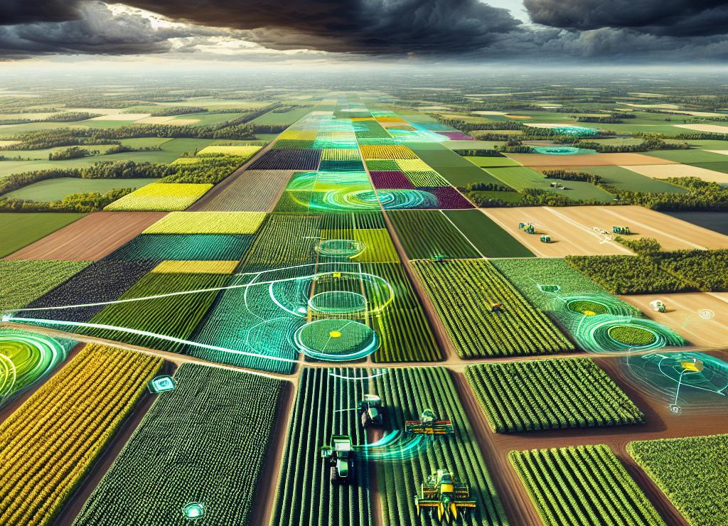
Applications of Image Processing with Green Technology and Sustainability
4. Climate Change and Environmental Research
Glacier Monitoring:
Image analysis of glaciers over time provides data on glacier melting rates and sea-level rise.
Climate Modeling:
Historical images of ecosystems, weather patterns, and ocean conditions provide data for climate models.
Ecosystem Health Assessment:
Satellite and aerial imagery track ecosystem health by assessing plant and soil conditions, biodiversity levels, and water availability.
Source :
https://farmonaut.com/canada/2024-challenges-ontario-and-quebec-vegetable-processors-face-climate-change-and-global-competition/
Notes:
Climate Change and Environmental Research
Glacier Monitoring: Image analysis of glaciers over time provides data on glacier melting rates and sea-level rise, helping scientists track climate change impacts.
Climate Modelling: Historical images of ecosystems, weather patterns, and ocean conditions provide data for climate models, which aid in predicting future environmental changes and planning mitigation strategies.
Ecosystem Health Assessment: Satellite and aerial imagery track ecosystem health by assessing plant and soil conditions, biodiversity levels, and water availability. These insights help in ecosystem conservation and sustainable resource management.

Slide 24

Lab Activity
Hands On
Lab 1
Forest Fire Detection Using Teachable machine

Slide 25
Lab Activity
Hands On
Lab 2
Waste Sorting Using Teachable machine.docx

Slide 26

Conclusion
Introduces fundamental concepts in digital image processing, covering image structure, pixels, color models, and types of images.
Explains key image quality attributes such as resolution, size, and aspect ratio, and their effects on image application.
Covers practical techniques for image enhancement, including smoothing, sharpening, and thresholding for segmentation.
Illustrate OpenCV for basic image manipulation.
Demonstrates image processing applications in machine learning using Google’s Teachable Machine for image recognition and classification.
Highlights sustainable applications of image processing in green technology.
Source :
www.freepik.com/

Slide 28
References
https://digital-photography-school.com/understand-pixels-resolution-resize-photoshop/
https://www.adobe.com/uk/creativecloud/photography/discover/image-resolution.html
https://www.javatpoint.com/difference-between-rgb-and-cmyk
https://www.javatpoint.com/dip-types-of-images
https://www.techtarget.com/whatis/definition/resolution
https://www.geeksforgeeks.org/image-enhancement-techniques-using-opencv-python/
https://www.scaler.com/topics/thresholding-in-image-processing/
https://www.geeksforgeeks.org/image-classification-using-googles-teachable-machine/
https://accedia.com/insights/blog/10-business-applications-of-image-processing-and-recognition-technology
https://www.ijraset.com/research-paper/green-path-project-develops-using-image-processing

Slide 29


Let’s Start

Slide 30


Quiz
What does the resolution of an image refer to?
The total number of colors in the image
The number of pixels along the width and height of the image
The compression method used for the image
The file format of the image
Answer: B
The number of pixels along the width and height of the image
Notes:
What does the resolution of an image refer to?
The total number of colors in the image
The number of pixels along the width and height of the image
The compression method used for the image
The file format of the image
Answer: B

Slide 31
Quiz
2. What is the primary purpose of image sharpening?
To remove noise from the image
To enhance the contrast between pixels
To make edges in the image clearer and more defined
To reduce the size of the image
Answer: C
To make edges in the image clearer and more defined
Notes:
What is the primary purpose of image sharpening?
A. To remove noise from the image
B. To enhance the contrast between pixels
C. To make edges in the image clearer and more defined
D. To reduce the size of the image
Answer: C

Slide 32
Quiz
3. In image processing, what is the main goal of thresholding?
To enhance image resolution
To convert a grayscale image into a binary image
To smooth the image for noise reduction
To increase the image brightness
Answer: B
To convert a grayscale image into a binary image
Notes:
Which of the following statements about OpenCV is true?
A. OpenCV is primarily a data processing library for financial transactions.
B. OpenCV is an open-source library focused on image processing and computer vision tasks.
C. OpenCV was developed to primarily support machine learning-based data analysis.
D. OpenCV is a closed-source, commercial software for video analysis only.
Answer: B

Slide 33
Quiz
4. When training an image model on Teachable Machine, what must you do with your images before uploading them?
You need to manually label each pixel in the image.
Apply filters to enhance the image quality.
Organize images into separate classes or categories before uploading.
Convert the images into a single color scheme.
Answer: C
Organize images into separate classes or categories before uploading.
Notes:
When training an image model on Teachable Machine, what must you do with your images before uploading them?
A. You need to manually label each pixel in the image.
B. Apply filters to enhance the image quality.
C. Organize images into separate classes or categories before uploading.
D. Convert the images into a single color scheme.
Answer: C

Slide 34
Quiz
5. Which of the following actions is NOT part of the Teachable Machine process when training an image classification model?
Uploading images for training
Defining labels for the images
Running a predefined image classification algorithm on your own dataset
Manually segmenting the image for feature extraction
Answer: D
Manually segmenting the image for feature extraction
Notes:
Which of the following actions is NOT part of the Teachable Machine process when training an image classification model?
A. Uploading images for training
B. Defining labels for the images
C. Running a predefined image classification algorithm on your own dataset
D. Manually segmenting the image for feature extraction
Answer: D

Slide 35
Thank You
Notes:
Thank You !!

